Slide 1

Retail Analytics
SQL Project
BY Shahzeb Zafar

Slide 2
INTRODUCTION
In today's competitive retail landscape, understanding customer Behaviour Optimising inventory, and improving sales performance are essential for business success. This project focuses on a retail company facing challenges such as stagnant growth and declining customer engagement. Using SQL and data analytics, we aim to uncover insights from sales transactions, customer profiles, and product inventory data to identify high and lowperforming Products, segment customers for targeted marketing, and Analyse customer Behaviour to enhance retention strategies. Through this analysis, we seek to develop actionable recommendations to drive growth, improve customer satisfaction, and streamline inventory management.

Slide 3
BUSINESS PROBLEM
The retail company has observed stagnant growth and declining customer engagement metrics over the past quarters. Initial assessments indicate potential issues in product performance variability, ineffective customer segmentation, and lack of insights into customer purchasing behavior. The company seeks to leverage its sales transaction data, customer profiles, and product inventory information to address the following key business problems: Product Performance Variability: Identifying which products are performing well in terms of sales and which are not. This insight is crucial for inventory management and marketing focus. Segmentation: The company lacks a clear understanding of its customer base segmentation. Effective segmentation is essential for targeted marketing and enhancing customer satisfaction. Customer Behaviour Analysis: Understanding patterns in customer behavior. including repeat purchases and loyalty indicators, is critical for tailoring customer engagement strategies and improving retention rates.

Slide 4
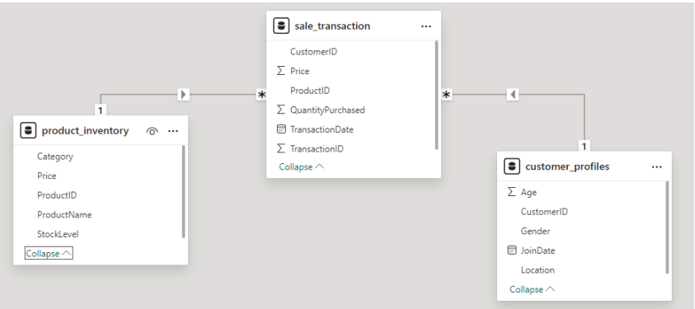
ENTITY RELATIONSHIP DIAGRAM

Slide 5
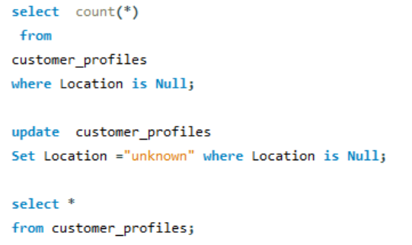
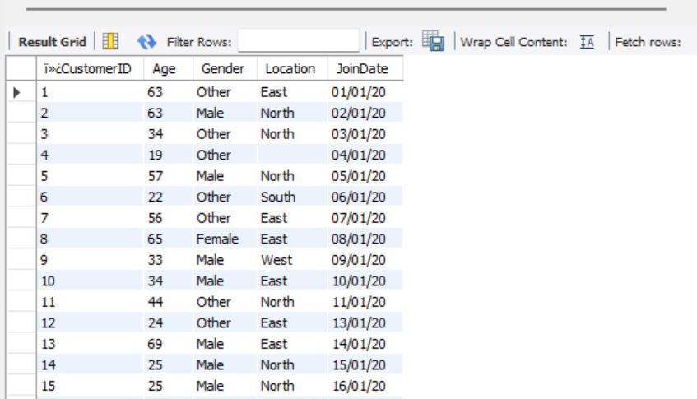
QUESTION 1
Write a SQL query to identify the null values in the dataset and replace those by “Unknown”.

Slide 6
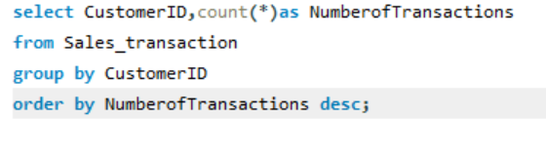
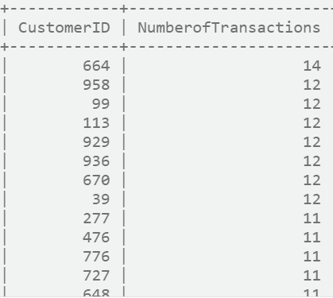
QUESTION 2
Write a SQL query to count the number of transactions per customer to understand purchase frequency.

Slide 7
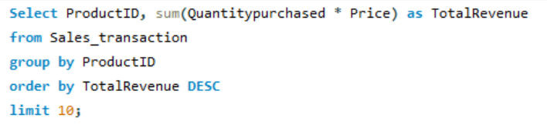
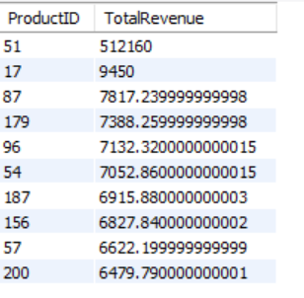
QUESTION 3
Write a SQL query to find the top 10 products with the highest total sales revenue from the sales transactions. This will help the company to identify the High sales products which needs to be focused to increase the revenue of the company.

Slide 8
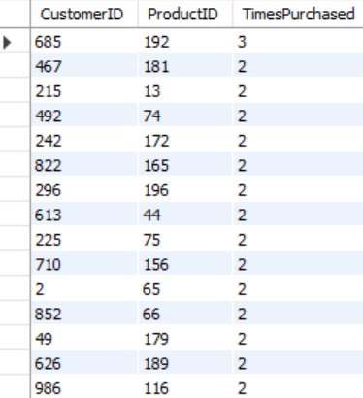
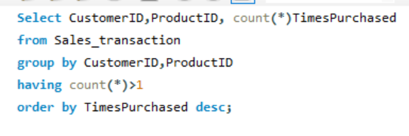
QUESTION 4
Write a SQL query that describes the total number of purchases made by each customer against each productID to understand the repeat customers in the company.

Slide 9
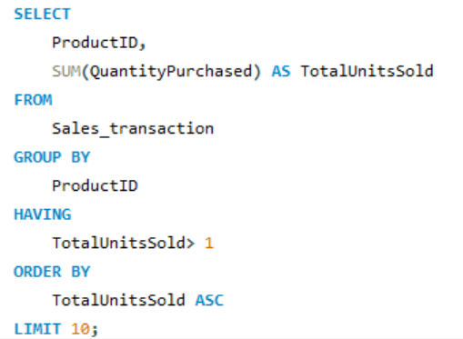
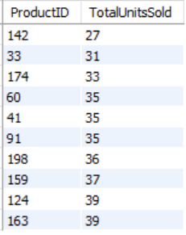
QUESTION 5
Write a SQL query to find the ten products with the least Amount of units sold from the sales transactions, provided that at least one unit was sold for those products.

Slide 10
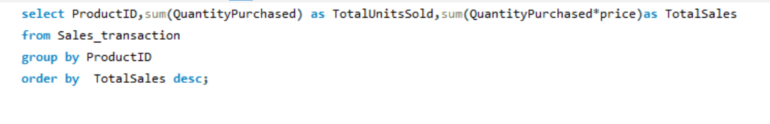
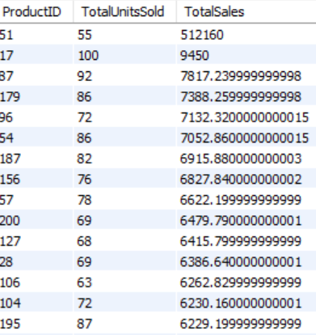
QUESTION 6
Write a SQL query to summarize the total sales and quantities sold per product by the company

Slide 11
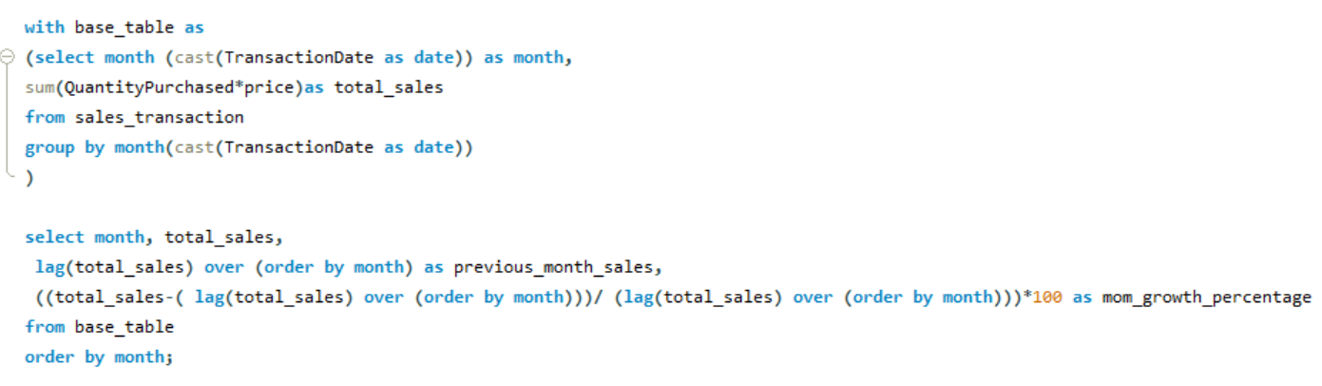
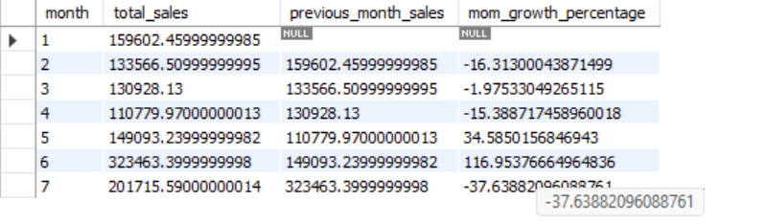
QUESTION 7
Write a SQL query to understand the month on month growth rate of sales of the company which will help understand the growth trend of the company. Return the result table ordering by month.

Slide 12
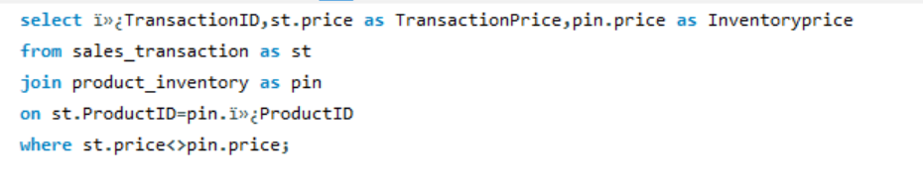
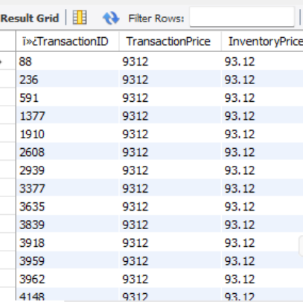
QUESTION 8
Identify the discrepancies in the price of the same product in "sales_ transaction" And "product _ inventory" tables

Slide 13
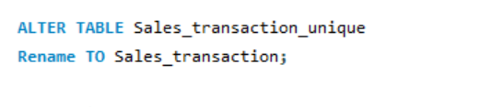
QUESTION 9
Replace the name of the new table with the original name

Slide 14
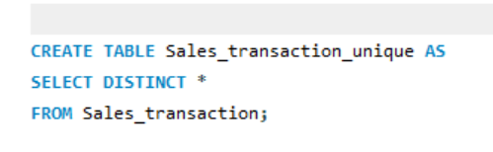
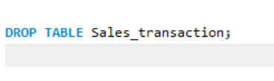
QUESTION 10
Create a separate table containing the unique values
Remove the the original table from the databases

Slide 15
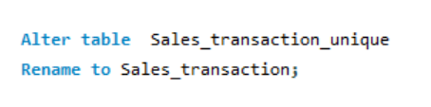
QUESTION 11
Replace the name of the new table with the original name

Slide 16
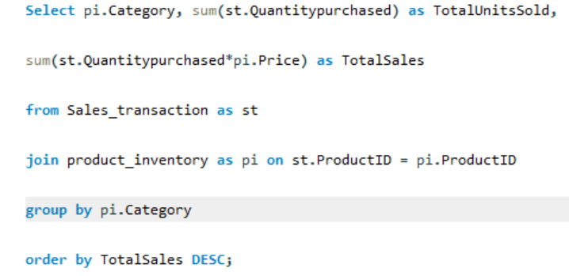
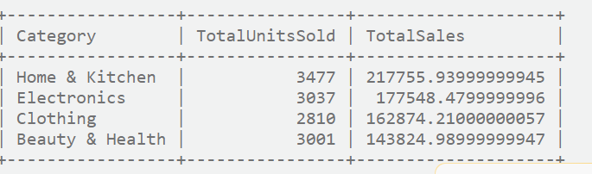
QUESTION 12
Write a SQL query to evaluate the performance of the product categories based on the total sales which help us understand the product categories which needs to be promoted in the marketing campaigns

Slide 17

Thank YOU

